Slide 1
Grid solver example
Gauss-Seidel (near-neighbor) sweeps to convergence
interior n-by-n points of (n+2)-by-(n+2) updated in each sweep
updates done in-place in grid, and diff. from prev. value computed
accumulate partial diffs into global diff at end of every sweep
check if error has converged (to within a tolerance parameter)
if so, exit solver; if not, do another sweep

Slide 2
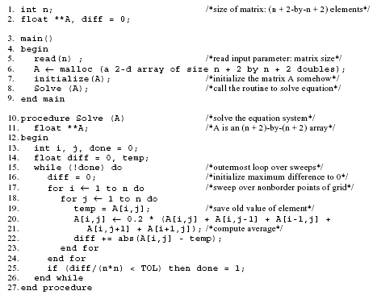
Sequential Version

Slide 3
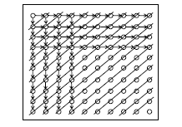
Concurrency O(n) along anti-diagonals, serialization O(n) along diag.
Retain loop structure, use pt-to-pt synch; Problem: too many synch ops.
Restructure loops, use global synch; imbalance and too much synch
First Parallel Version

Slide 4
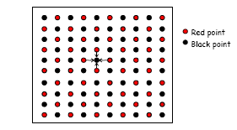
Exploit application knowledge
Reorder grid traversal: red-black ordering
Different ordering of updates: may converge quicker or slower
Red sweep and black sweep are each fully parallel
Global synch between them (conservative but convenient)
Ocean uses red-black; we use simpler, asynchronous one to illustrate
no red-black, simply ignore dependences within sweep
sequential order same as original, parallel program nondeterministic

Slide 5
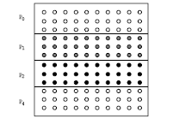
Assignment
Static assignments (given decomposition into rows)
block assignment of rows: Row i is assigned to process floor(i/p)
cyclic assignment of rows: process i is assigned rows i, i+p, and so on
Dynamic assignment
get a row index, work on the row, get a new row, and so on
Static assignment into rows reduces concurrency (from n to p)
block assign. reduces communication by keeping adjacent rows together

Slide 6
MATRIX MULTIPLICATION
The product of an m x n matrix A by an n x k matrix B is an m x k matrix C.
The pseudo code is :
procedure matrix_multiplication(A, B, C) is
for i = 1 to m do
for j = 1 to k do
cij = 0;
for s = 1 to n do
cij = cij + (ais * bsj);
end for;
end for;
end for;
This procedure takes m*k*n steps.

Slide 7
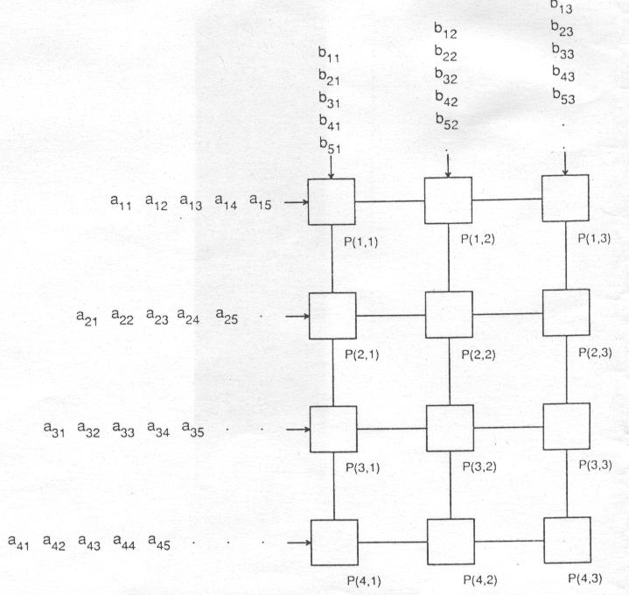
MATRIX MULTIPLICATION
Mesh Matrix multiplication:

Slide 8
MATRIX MULTIPLICATION
Mesh Matrix Multiplication:
procedure mesh_matrix_multiplication(A, B, C)
for i = 1 to m do in parallel
for j = 1 to k do in parallel
cij = 0;
while P(i, j) receives 2 inputs a and b do
cij = cij + (a * b);
if i < m then send b to P(i +1, j )
end if;
if j<k then send a to P(i, j+1);
end if;
end while;
end for;
end for;
This procedure takes max(m,k)+n steps (latency).

